Slide 1
Sustainability & Energy Management at York Guest Lecture
The Next Hundred Million Reasons
Brad Cochrane, Director, Energy Management
2015

Slide 2
Sustainability & Energy Management
AGENDA
Introductions and Opening Remarks
Keele Campus Overview
York University Energy Management Overview
YorkW!$E Energy Management Project Overview
Scheduling Opportunity – A great first year
New Steam Chiller Project
.

Slide 3

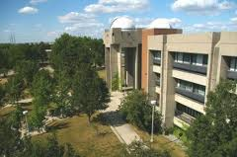
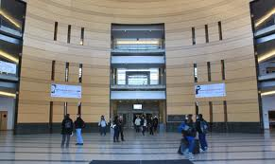
Keele Campus Overview
KEELE CAMPUS
Founded in March 1959, and is now Canada's third-largest university
Canada's leading interdisciplinary research and teaching university
Over 55,000 students and growing fast
Expansion of undergraduate engineering program
Major Faculty of Environmental Studies
Over 7,000 employees
Single largest campus in Canada
8,000,000 sq. ft.
21MW electrical peak load (and growing with new Life Sciences Building, Stadium and Lassonde School of Engineering building)
Over 12,000 tons of centralized chillers for air conditioning
Prime opportunity for peak shaving
Provincially designated host site for nuclear incident
Similar to scope of City of North Bay
Motto – redefine THE POSSIBLE,
Tentanda Via: The Way must be tried

Slide 4
Energy Management Overview
Energy Management Department’s primary function is to provide;
Heating,
Cooling,
Power, and
Water to all academic, administrative, retail, and residences on campus
Administer large energy retrofit project.
Central Utilities:
Generates high pressure steam (250psi, 1,724kPa) for heating and 5ºC chilled water for cooling,
Delivers these by way of underground service tunnels to mechanical rooms of each building for distribution to the various heating, ventilating, and air conditioning (HVAC) units within the building
Generate and distribute power through our 10 megawatt co-generation plant and associated 13,800 volt electrical distribution system.
The Energy Management unit is a 24-hour per day, 365 days per year operation that is staffed by highly skilled technicians and management whose sole responsibility is to provide the utilities requirements of our community in a safe and efficient manner and in accordance with all regulatory requirements.

Slide 5
Energy Management Overview
Historical Operating Budget - $25 million (almost $70,000/day, $0.80/sec)
Natural Gas 35%
Electricity 40%
Water 10%
Oil – backup <1%
Maintenance and Operations 15%
Previous energy management projects:
$17,000,000 natural gas fired co-generation facilities – 5MW in1997, additional 5 MW in 2003

Slide 6
Energy Management Overview

Slide 7
YorkW!$E Energy Management Project
In September 2005, the concept of an Energy Performance Contracting Program
was finalized, which aimed to invest $41,000,000 in plant and building system
renewal and retrofit projects so that annual energy costs and greenhouse gases
could be reduced by 25%.
In November 2005, MCW Custom Energy Solutions Ltd. was selected as the
successful contractor.
In February 2006, the pilot project for the YorkW!$E Energy Management
Program was brought forward for Board approval.
Since that time, numerous energy conservation measures have been approved and
implemented in campus buildings and in the central plant and utility distribution
systems with >$3,330,000 in utility company incentives to date being reinvested (with another $1,030,000 in payment processing for new steam chiller, and other lighting and compressor upgrades pending).

Slide 8
YorkW!$E Energy Management Project
Current Status
At this juncture, the $41,000,000 program is over 90% complete, with all projects funding committed.
Results have been very positive as weather-normalized savings have been calculated at 22%. The project is well along the path to reaching the 25% goal, even with the 5% Campus growth in buildings, and a higher student population.
Metering installed as a foundation measure in this program has created the tools to underpin engagement success stories like the ‘Res Race to Zero’. This provides us new insight to shape future upgrades and initiatives, and to target ongoing energy reduction/conservation activities.
We continue to pursue available incentives with our contractor MCW Custom Energy Solutions Ltd. to support the project and are proud of the incentive revenues.
Our carbon footprint has been reduced and the reductions have facilitated capital cost avoidances by creating infrastructure capacity for the addition of the new Life Sciences, Pan Am Stadium, Bergeron LSE Buildings and future 2nd Student Centre. (=Sustainability, no new resources)

Slide 9
YorkW!$E Energy Management Project
Package 1 Lighting Upgrade Incentive Cheque

Slide 10
YorkW!$E Energy Management Project
Quick Stats – Campus Buildings
51 Buildings across both Campus have had new energy efficient lighting installed
that has reduced lighting demand by over 2.5 MW (2,500 kW)
31 Buildings have had major controls upgrades adding over 2,000 new control and
monitoring points (examples - temperature, humidity, flow, pressure, CO₂)
141 Variable Speed drives have been added to 19 Campus buildings representing 3,185
hp of fan power converted to Variable Air Volume Control (VAV)
2,350,000 CFM of ventilation on Campus has been converted to VAV
160 new utility meters installed on Campus (Keele Campus)

Slide 11
YorkW!$E Energy Management Project
Quick Stats – Central Utilities Building (CUB)
new Variable Speed Drives (VSD) have been installed as part of the cooling system upgrades in the CUB. (Chilled Water pumps and Cooling Tower #3)
350 hp of new VSD’s have been installed as part of the heating system
upgrades in the CUB (Boiler Feed water Pumps).

Slide 12
Scheduling Opportunity
What are the major opportunities and critical technical and incentive challenges going forward to reduce consumption and peak demand of chilled water load for air conditioning:
First tackle reduction of load – manually optimize classroom utilization
scheduling with building automation scheduling (turn off what is not in use, work toward proactive scheduling techniques)
Study completed on summer 2010 classroom utilization, large conservation opportunity
We believed we could harvest up to 0.5 MW in load reduction (direct and indirect), in the summer months.

Slide 13
Period of Low Occupancy
In 2010, a study identified opportunities to reduce consumption during periods of low occupancy:
Weekends
Statutory Holidays
Lead in/lead out
Exams/Reading Week
Summer Schedule

Slide 14
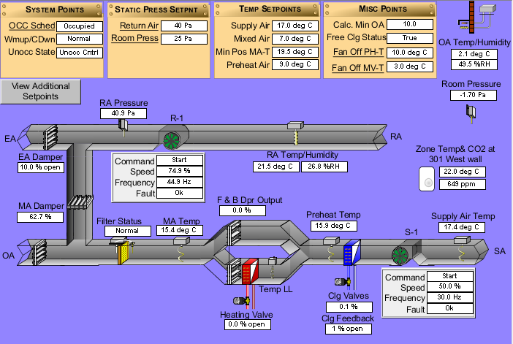
Example of Building Automation System HVAC Interface - Curtis Lecture Hall

Slide 15
Family Day Test Weekend
Pilot project began in January of 2012
First test occurred on the family day weekend targeting 127 building ventilation fans in 19 buildings

Slide 16
Results: Electricity
8,736.47 kWh electricity saved each day, on average, which saved $611.55 - 873.65 per day, assuming a rate of 7 to 10 cents per kWh, associated heating savings on same order approximately $720 per day (rates higher now)

Slide 17
Extrapolated over a Year?
Weekends (104 days)
Statutory Holidays (32 days)
Annual Electricity Savings 83,171.21$ to 118,816.01$ (rates about 20% higher now)

Slide 18
Case Study: Curtis Lecture Halls
Total Annual Electricity Consumed in 2011:
1,093,235 kWh

Slide 19
Curtis Lecture Halls
Curtis Lecture Hall consumed 18.3% less energy during the test weekend resulting in a decrease in consumption by 535 kWh/day.
Expanded over a year, this would equate to 73,101 kWh in Curtis Lecture Halls - nearly 0.7% of the building’s total annual electricity consumption.

Slide 20
So what did 2012 scheduling achieve?
Nothing less than amazing - absolute year over years savings of over 3%, (3,863,971 kWhr)
Cooling Degree Days were up 14.8% (more air conditioning)
Chilled Water for air conditioning DOWN 5.8%
Chilled Water produced per Cooling Degree Day DOWN 17.9%
Order of magnitude in $$$ saved - $350,000

Slide 21
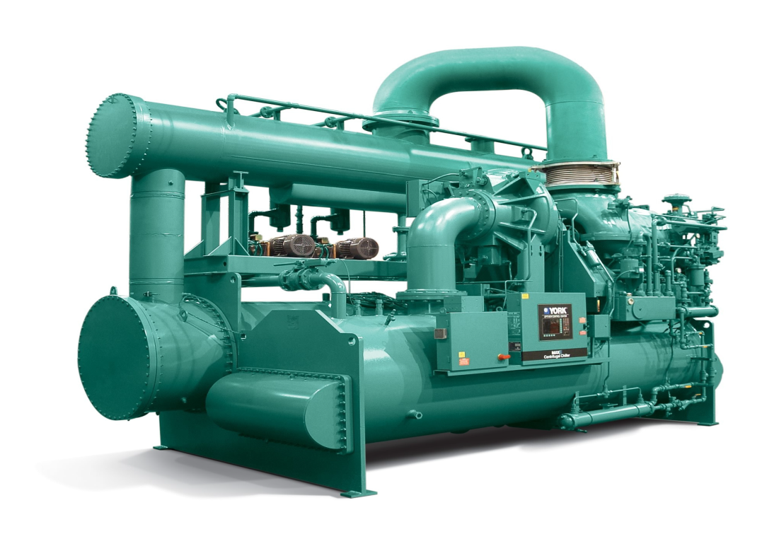
What next on the journey to reducing consumption?
Completed review of possible next steps in early 2012 as natural gas prices had fallen making some original HVAC heating measures financially unattractive, were there now better unforeseen options – ANSWER: YES

Slide 22
New Tri-generation Steam Turbine Chiller Project (nicknamed “King Kong” by plant operators)
Board of Governors approved of $5,000,000 budget to engineer, procure and install a 3,000 ton tri-generation steam turbine driven chiller in the Keele Campus Central Utilities Building
This project has several attributes which independently substantiate the concept;
  Reduced energy consumption and associated environmental stewardship (reducing annual electrical consumption by 5,231,000 kWh and peak consumption by 2MW, over 4,000 tons of CO2 avoided assuming imported coal fired peaking generation, twice the capacity and efficiency, part load efficiency almost 4 x better during start up testing)
  Requirement for Incremental Peak Cooling Capacity – various new buildings
  Maximizing York Electrical Power Generation – unloads back end cogen boiler steam constraint (2.8MW gain in August 2014 commissioning and testing)
  Minimization of Imported Power and reducing cost of purchased electricity Investment Business Case and Incentive Timeliness (<8 year payback, with an electricity saving of $523,101/year, incentive over $1,030,000 on electricity, $44,000 on natural gas)
  Modernization and reliability – replaces very inefficient obsolete 1964 unit
  Infrastructure Cost Avoidance – electrical sub-stations, new chillers

Slide 23
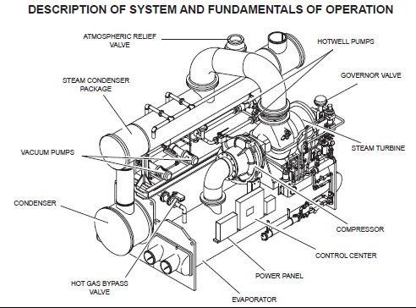
New Tri-generation Steam Turbine Chiller Project

Slide 24
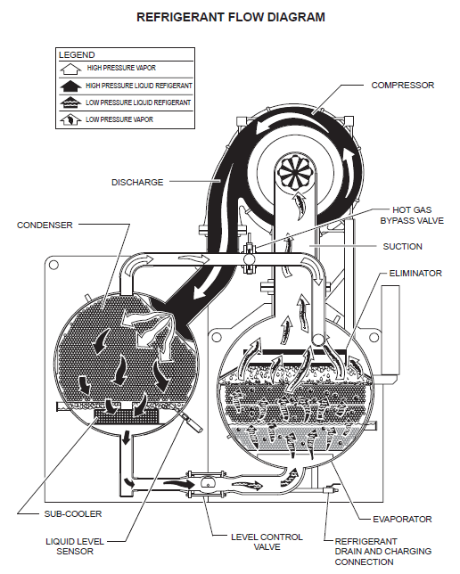
New Tri-generation Steam Turbine Chiller Project

Slide 25
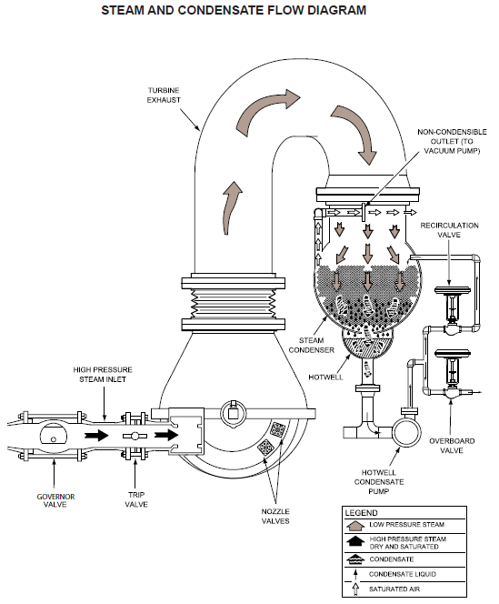
New Tri-generation Steam Turbine Chiller Project, steam recovered from back of natural gas turbines (co-generation)

Slide 26
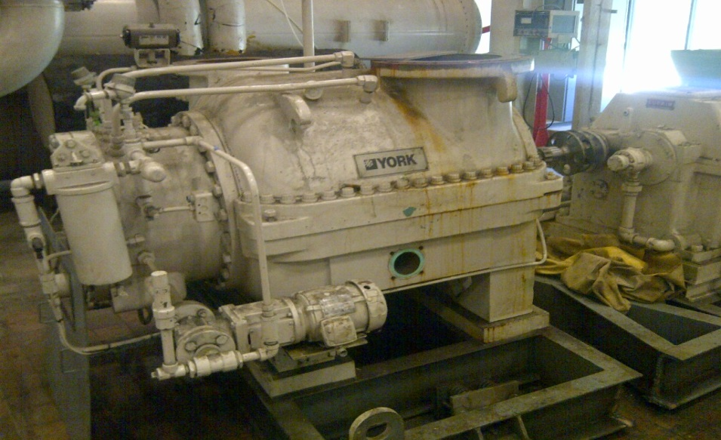
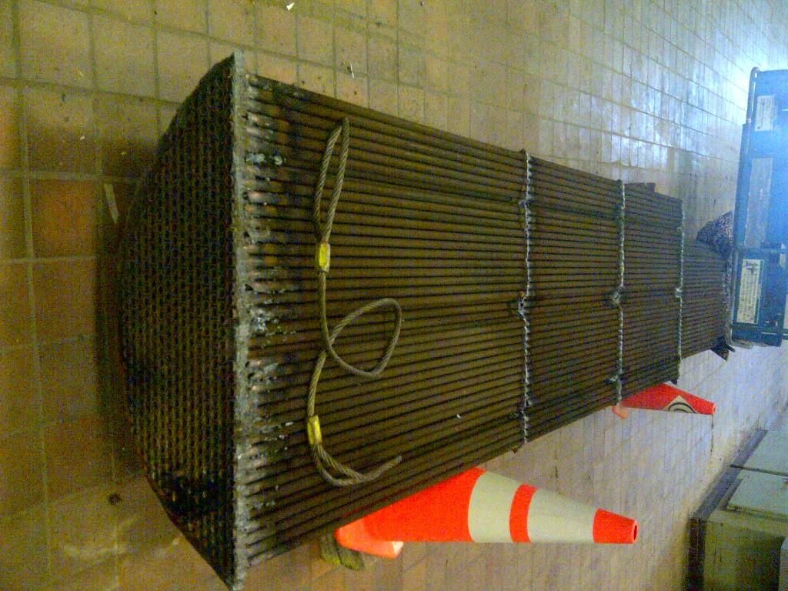
Old 1964 Chiller on the way out!

Slide 27
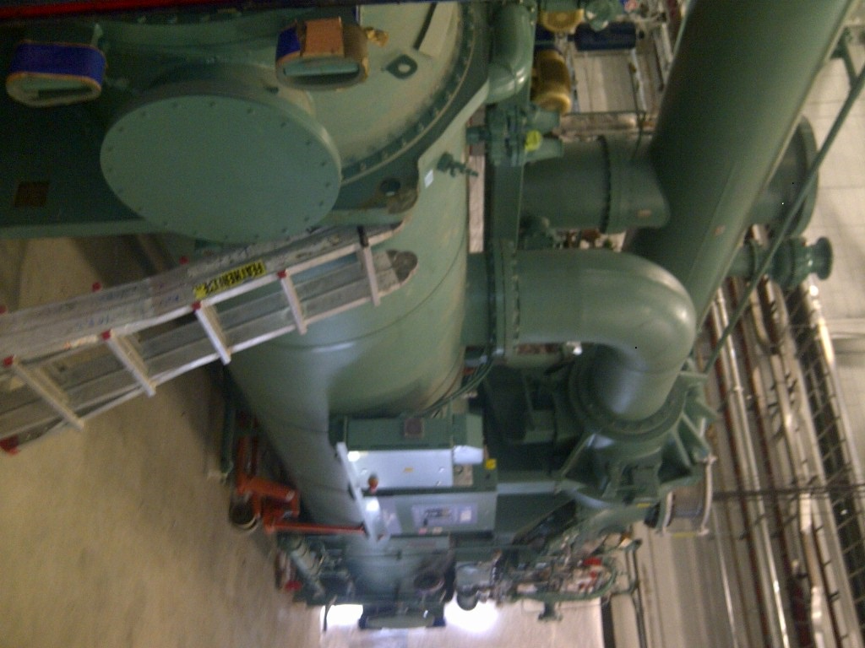
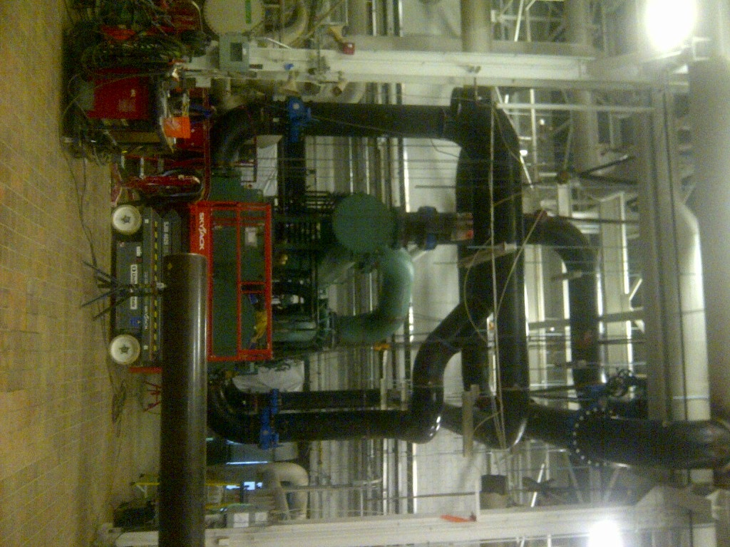
New 2014 Chiller Installation in the Central Utilities Building

Slide 28
The Next Hundred Million Reasons
Who did the math for Keele Campus Totals?
2012 kWh: 103.6 million kWh
New Steam Turbine Chiller 5.2 million kWh
2014 Target (now 2015) 98.4 million kWh
But……
Glendon consumes roughly 5.2 million kWh/yr = grand total still 103.6

Slide 29
The Next Hundred Million Reasons
Amazing accomplishments we can all be proud in terms of sustainability progress
First 30,000,000 kWh reduced but there are still hundreds of opportunities with daylight harvesting, and new technology opportunities like LEDs (active trials in parking garages, some high ceiling areas completed at cost of $100k), and laboratory HVAC ACH modulation (Lumbers pilot)
Need to deal with increasing costs (e.g. April 1, 2015 water goes up another 8%), infrastructure replacement and universal climate change challenges are increasing (new HFC refrigerant & GHG /carbon tax regulations)
Join us on the continuing journey to tackle the remaining 100 million kWhs

Slide 30
Questions (Easy)?
Brad Cochrane
email: bcochran@yorku.ca

